Slide 1


Welcome to ICPC NU !
Week 1

Slide 2


Outline
Introduction and motivation
The headers and namespace in C++
Variables and keywords
Data Types
Operators
Input and output
Conditionals
Solve 2 – 3 questions

Slide 3


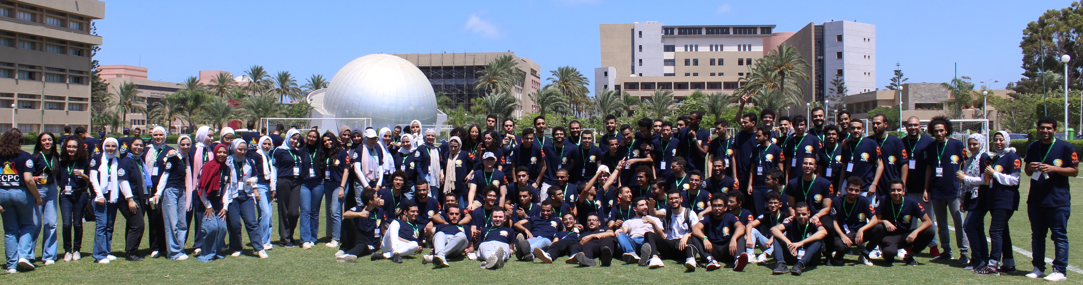
What is ICPC NU ?
Competitive programming community
Training together for the yearly ECPC Qualifications
Help students be better problem solvers (help in job applications)
All mentors are here to help you, so feel free to ask ANYTHING and give us your feedback
Our lovely community!

Slide 4

Motivation !
It is going to be TOUGH, and that is part of the process
Take it as a challenge
To get out of your comfort zone
Exercise your brain

Slide 5


Question / story
Mariam has opened a bookstore, and she wants to make a program that identifies what category does the user fit to (children – teen - Adult), and print the result too!

Slide 6
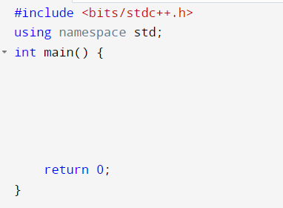
C++ file format
Header file, that includes every standard library
Namespace, to not write std before words like cout and cin
Main function, where we write our code

Slide 7
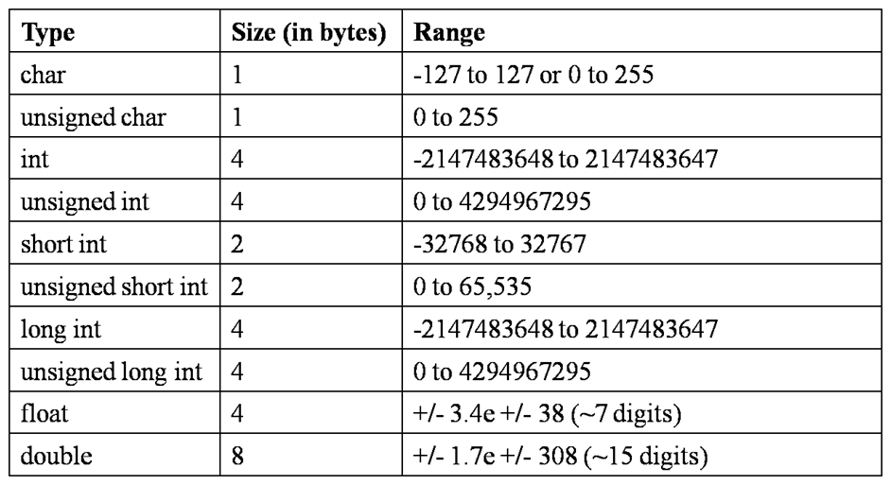
Data Types
long
When it is more than 10^9

Slide 8

What is a variable ?
We need a container to save the values to manipulate later
Like what in our example?

Slide 9
How to name our variables ?
A variable name must start with a letter or an underscore character (_)
A variable name can only contain alpha-numeric characters and underscores (a-z, A-Z, 0-9, and _ )
Variable names are case-sensitive (age, Age and AGE are three different variables)
A variable name cannot contain spaces
The variable name cannot be any Go keywords

Slide 10
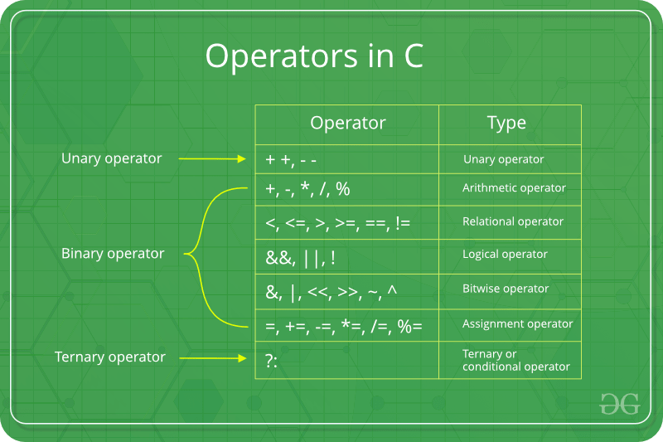
Operators

Slide 11
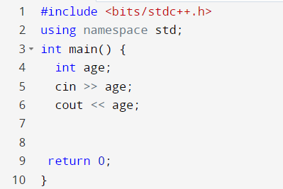
Input and output
Data type
Variable name
Input
Output

Slide 12
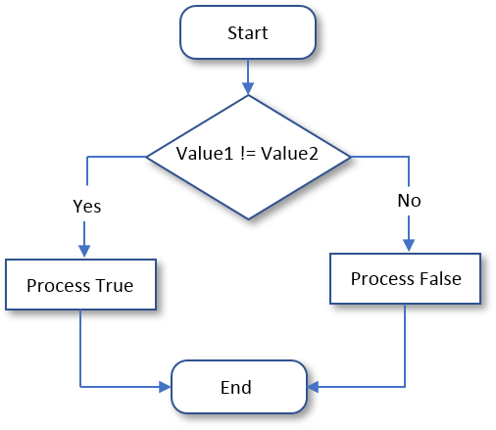
Conditional

Slide 13
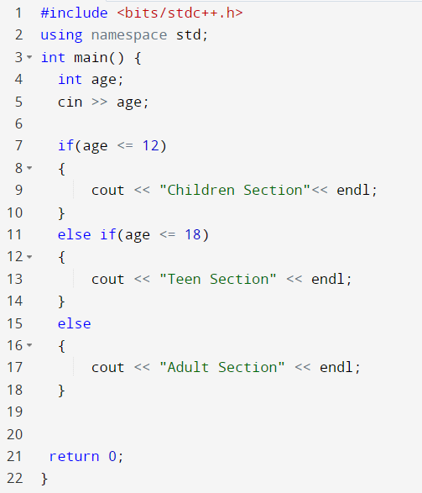

Slide 14
Utility functions
min(a,b)
max(a,b)
floor(a)
ceil(a)
abs(a)
sqrt(a)

